Slide 1
BCG RISE 2.0
BDA Wave 22 Capstone Project - Group 2
QINET Retailer Case Study
September 2025
Team Members: ANG HWEE SIANG
LI KAH YAN O WOON LENG SARIKA SINGH SEAH XIN NI

Slide 2
AGENDA
Overview
Preliminary Findings and Observations
Data Analysis (Customer segmentation, Soft churn analysis, Profit analysis)
Forward Looking Map
Q&A

Slide 3

OVERVIEW
3 Key Challenges
Churn
Profitability
Engagement
Solution Focus
Know retailer behavior
Detect risks early
Re-engage retailers effectively
Notes:
Qinet Retailer App: B2B ecommerce platform meticulously crafted to streamline order placement process between FMCG retailers and distributors, enhancing operational efficiencies and strengthening competitive positioning
Business Challenge: Amid intense market competition, Qinet seeks to understand their retailer profiles and segments, identifying those who may likely be reducing their engagement and devising retention strategies for re-engagement

Slide 4
PRELIMINARY FINDINGS AND OBSERVATIONS

Slide 5
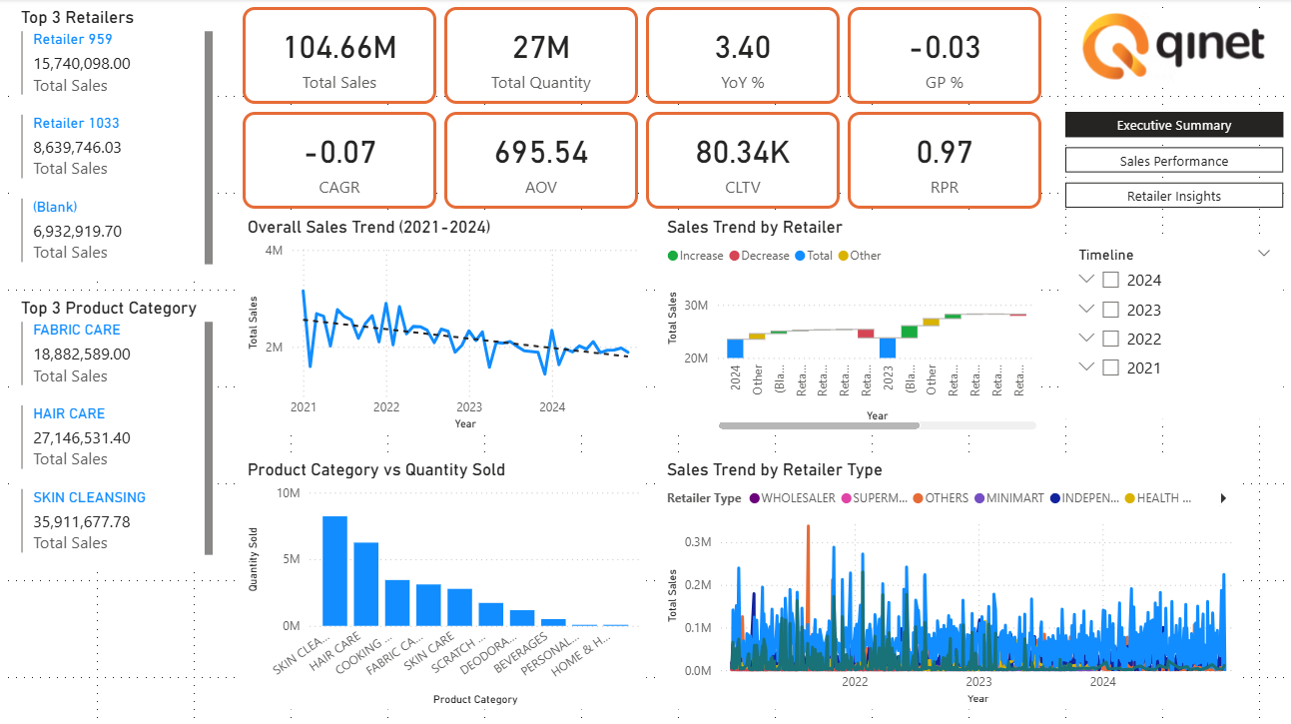
Notes:
Simple data clean up and Power BI Analysis
What is the behaviour analysis – Quantity Sold, Invoice Date
What is the Distributor and Retailer Relationship – Quantity sold, List Price, Price Sold (base on economic of scales ?)
Any data collected for – Customer Feedback, Upon “termination of service”, Subscription Model

Slide 6
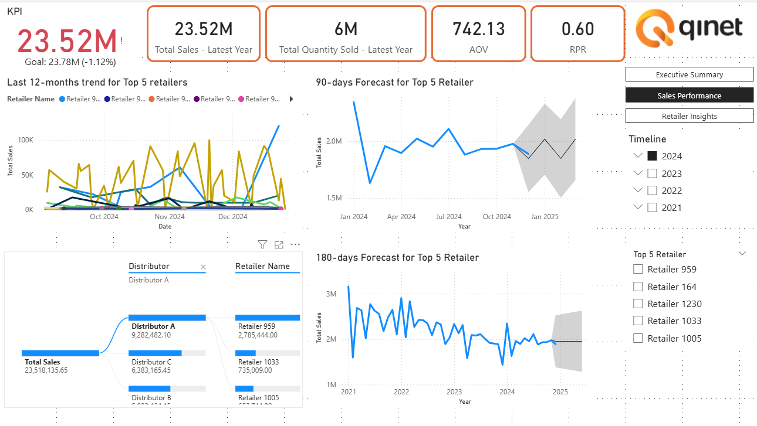

Slide 7
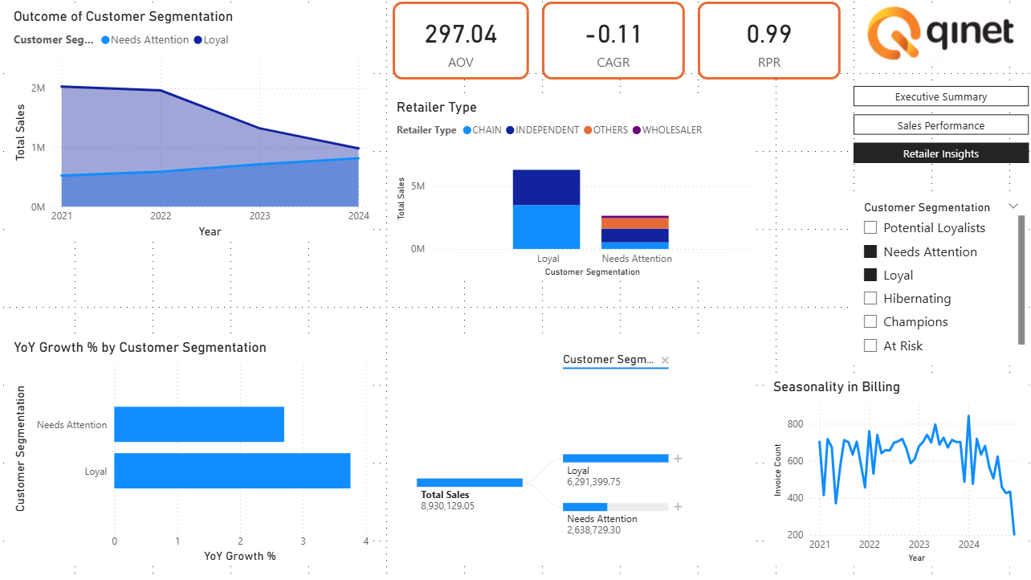
Notes:
Simple data clean up and Power BI Analysis
What is the behaviour analysis – Quantity Sold, Invoice Date
What is the Distributor and Retailer Relationship – Quantity sold, List Price, Price Sold (base on economic of scales ?)
Any data collected for – Customer Feedback, Upon “termination of service”, Subscription Model

Slide 8
PRELIMINARY FINDINGS AND OBSERVATIONS
This decline raises critical questions:
Are costs or product requirements driving the change?
Could the subscription model or app system issues be discouraging retailers?
Are buyer behavior patterns shifting in ways not captured?
Is feedback data being acted upon?
Or is it simply the economics of scale at play?
These insights highlight the need for deeper analysis — to truly understand retailer behavior, detect risks early, and re-engage with precision.
Notes:
For our reference!

Slide 9
DATA ANALYSIS

Slide 10
CUSTOMER SEGMENTATION
RFM Segmentation
RFM Segmentation is the most fitting:
✔ Clear rules and stable
✔ Interpretable and explainable
✔ Avoid unbalanced clusters
Data Cleaning & Pre-Processing
Feature Engineering
Date Parsing - Standardised date format dd/mm/yyyy across the data
Handling missing or null values - Either remove or fill in values
Handling duplicates and unused columns - Removing entries to ensure accuracy and performance efficiency
Creating new columns - Aggregate the total sales_amount based on unique invoice number
KMeans
Notes:
RFM scores by Quantiles vs. K-Means
RFM by Quantiles
Pros:
Simple and transparent (Top 20% of recent customer, R=5)
Easy to Interpret (R=5, F=1, M=1 is clearly recent but not frequent/high-spending)
Cons:
Cutoff may split similar customers
Equal-size group - Does not reflect natural clusters
RFM by K-Means
Pros:
Natural groupings (cluster by similarity)
Cons:
Harder to interpret (“Cluster 2” doesn’t tell you anything without profiling)
Requires scaling
Why did we use RFM by Quantiles?
Easier to start with quantile-based RFM scores
Simple
Interpretable and explainable
Avoid unbalanced clusters
Then, if the business needs more nuanced segmentation, experiment with K-Means (or other clustering like Gaussian Mixture Models) on the RFM features and compare results.

Slide 11
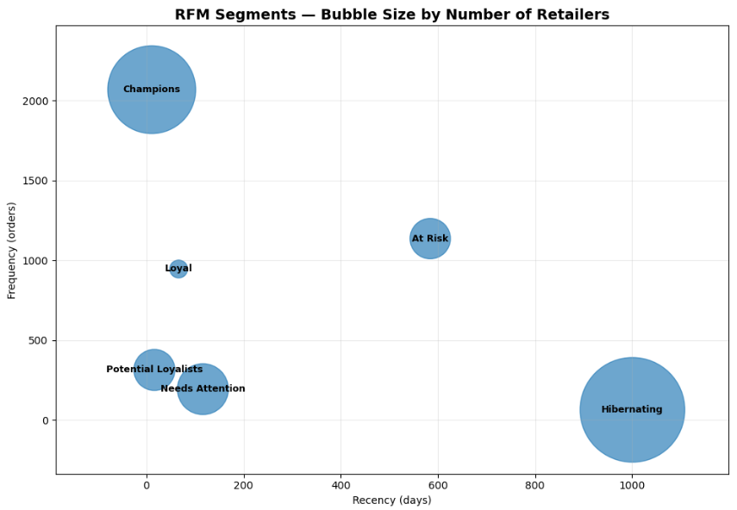
CUSTOMER SEGMENTATION
Champions | High Recency (4–5) = purchased very recently High Frequency (4–5) = purchased very often High Monetary (4–5) = spend the most
Loyal | Recency ≥ 3 and Frequency ≥ 4 Purchased frequently but may not spend as much as Champions.
Potential Loyalist | Recency ≥ 4 and Frequency ≥ 2 Recent customers with medium frequency – Potential to be nurtured into Loyal customer
Needs Attention | Recency = 3 and low Frequency Purchased within the last year - Potential to be nurtured into Potential Loyalist
At Risk | Recency ≤ 2 but Frequency ≥ 3 No recent purchases, used to buy often
Hibernating | Recency ≤ 2 and Frequency ≤ 2 Inactive for a long time
Notes:
RFM scores by Quantiles vs. K-Means
RFM by Quantiles
Pros:
Simple and transparent (Top 20% of recent customer, R=5)
Easy to Interpret (R=5, F=1, M=1 is clearly recent but not frequent/high-spending)
Cons:
Cutoff may split similar customers
Equal-size group - Does not reflect natural clusters
RFM by K-Means
Pros:
Natural groupings (cluster by similarity)
Cons:
Harder to interpret (“Cluster 2” doesn’t tell you anything without profiling)
Requires scaling
Why did we use RFM by Quantiles?
Easier to start with quantile-based RFM scores
Simple
Interpretable and explainable
Avoid unbalanced clusters
Then, if the business needs more nuanced segmentation, experiment with K-Means (or other clustering like Gaussian Mixture Models) on the RFM features and compare results.

Slide 12
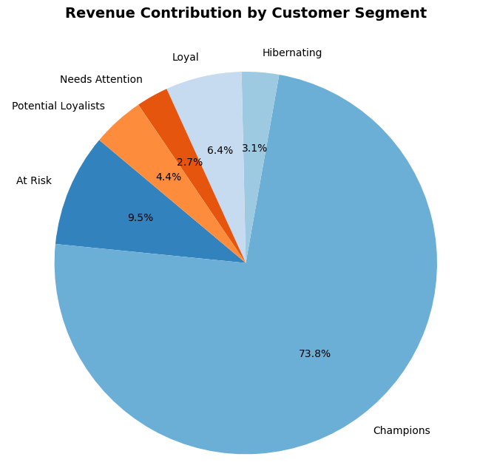
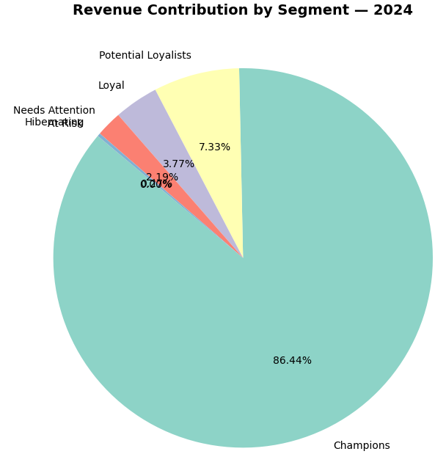
CUSTOMER SEGMENTATION - PROFIT ANALYSIS
OVERALL
2024
Potential Loyalist
Loyal
Needs Attention
Hibernating
At risk
Notes:
3 biggest contributors 2024: Champions, Loyal, Needs Attention [Unchanged]

Slide 13
PROFIT ANALYSIS (COMPARISON)
Segment | Total Revenue (2024) | Avg Revenue | Active Retailers (2024) | Contribution % (Avg ‘21 - ’24) | Contribution % (2024)
Champions | $12.5M | $95k | 132 | 51.3% | 52.0%
Loyal | $6.2M | $68k | 91 | 25.6% | 25.9%
Needs Attention | $3.1M | $27k | 115 | 12.3% | 12.9%
Potential Loyalists | $1.5M | $18k | 84 | 6.2% | 6.2%
At Risk | $0.7M | $12k | 60 | 3.0% | 2.9%
Hibernating | $0.2M | $3k | 72 | 1.6% | 0.1%
Notes:
Top 3 contribution% and total revenue: Champion, Loyal, Needs attention

Slide 14
“CHAMPION” - MONETARY TREND

Slide 15
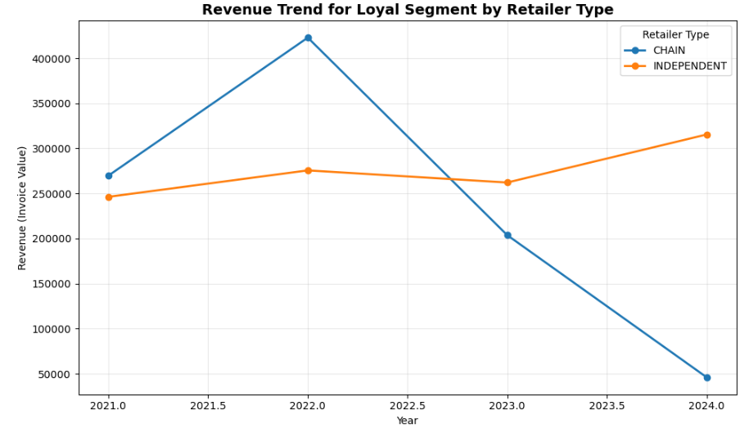
“LOYAL” - MONETARY TREND
Retailer Type | Revenue (Invoice Value)
CHAIN | $3,487,655
INDEPENDENT | $2,803,744
Notes:
CHAIN retailer drastically dropped off (Re-engage)
INDEPENDENT increased (~ +21.15pp) (Reward)
*Update text box for the % of revenue in 2024 and amount

Slide 16
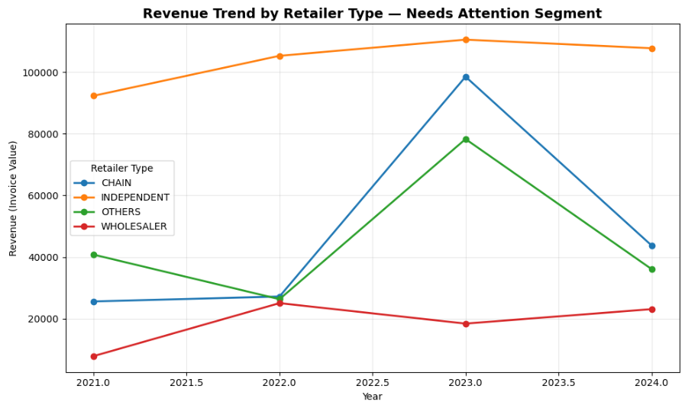
“NEEDS ATTENTION” - MONETARY TREND
Retailer Type | Revenue (Invoice Value)
INDEPENDENT | $1,093,373
OTHERS | $835,812
CHAIN | $527,610
WHOLESALER | $181,933
Notes:
INDEPENDENT generally consistent but decreased slightly 2023 > 2024
2023 sharp increase in CHAIN & OTHERS (Did Qinet do something?)
WHOLESALER generally consistent as well, increased slightly 2023 > 2024

Slide 17
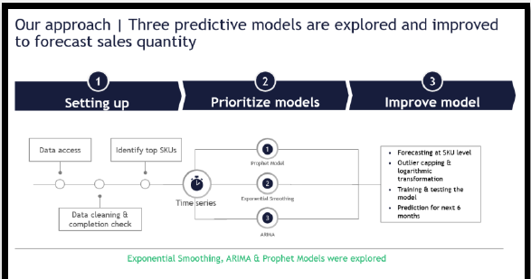

PREDICTIVE MODELS EXPLORED
let me re-do this flow
20% test, 80% train
Feature Assembly
Train / Test Split
XGBoost
avg_gap - average gap between purchases threshold = 3 * avg_gap soft_churn_label = Binary label indicating churn status, based on the 3× average purchase interval rule.
0 = Active (purchased within threshold)
1 = Soft churn
RFM scores from customer segmentation
Linear Regression
Decision Tree
Notes:
max_date is the anchor point for Recency score and for deciding whether a retailer has churned.
For each retailer, look at the last purchase date vs. the max date in the dataset. If the number of days since last purchase is greater than three times their average purchase interval (with min/max/fallback safeguards), mark them as churn (1). Otherwise, mark as active (0)

Slide 18
XGBoost
XGBoost is the most suitable:
✔ Best predictive performance
✔ Able to capture nonlinear churn patterns
✔ Less overfitting
WIP, to Insert:
ROC
Actual vs. Predicted (TRAIN TEST %)
aka our model validation. back up why we chose to pick this model. Also let qi net know “hey i think we’re pretty accurate”

Slide 19
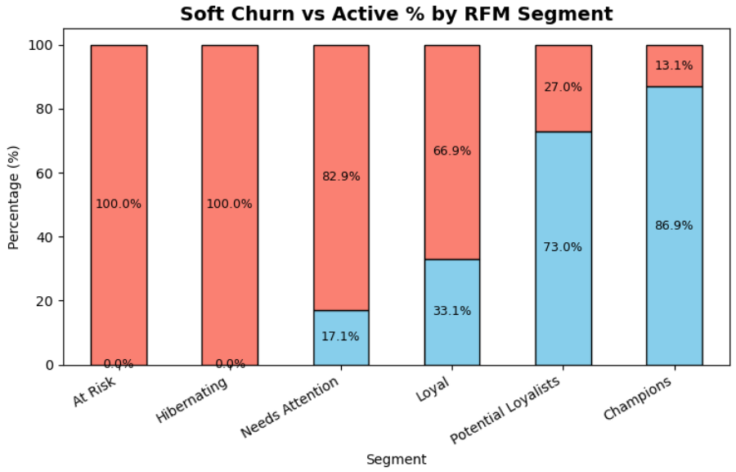
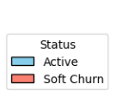
SOFT CHURN PREDICTION (2024)
Change the Bar graph to go in descending
Segment | Total no. of Retailers | No. of Churned | Churn rate
At Risk | 162 | 162 | 100.00
Hibernating | 346 | 346 | 100.00
Needs Attention | 181 | 150 | 82.87
Loyal | 136 | 91 | 66.91
Potential Loyalist | 163 | 44 | 26.99
Champions | 282 | 37 | 13.2
Notes:
Interpretation: At Risk & Hibernating: basically all of them are flagged as churned — not surprising given their inactivity.
Needs Attention: very high churn (83%), meaning this group is slipping fast.
Loyal: two-thirds churn — this is alarming, suggests “loyal” group isn’t very sticky.
Potential Loyalists: about 1 in 4 churned, manageable but watch closely.
Champions: only ~13% churn, strong retention.

Slide 20
FORWARD LOOKING ROADMAP

Slide 21
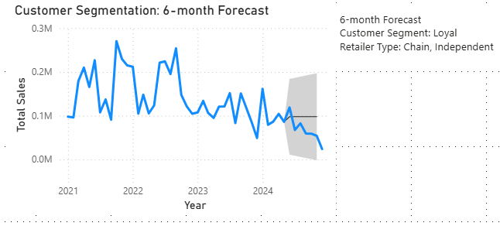
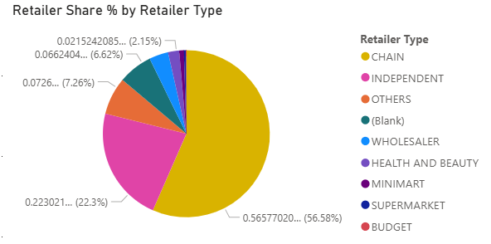
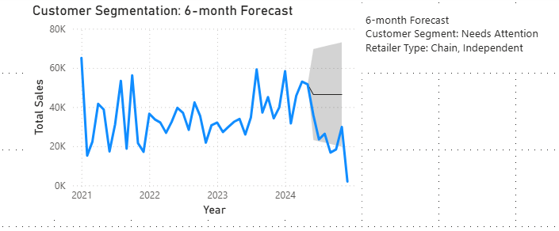
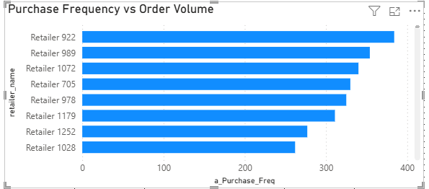
Customer segment: Loyal, Needs Attention
Retailer Type: Chain, Independent

Slide 22
Prioritization framework
High Impact
Subscription Tier
- Benefit Analysis
Retention Strategy
- Data Collection, Market Analysis, Behavioural Analysis
Low Effort
High Effort
Social Media Marketing
Refined Customer Experience
- Improve app interface
Low Impact

Slide 23
6 MONTHS FORWARD LOOKING ROADMAP
Retention Strategy - Data Collection, Market Analysis, Behavioural Analysis
Feedback Data - Behavioural purchase patterns, Revenue to Qinet, Exit info, App efficiency
Current Market Analysis - Economics, other competitors
2) Subscription Tier - Benefit Analysis
Review existing subscription models for “churn”, “likely churn models”
Review “Retailer” and “Distributor” : ‘Subscription tier’ to cater to different groups of users
To re-engage “likely churn”, to bump them onto nextgroup
3) Refined Customer Experience - Improve app interface
Notes:
Need to do a further analysis to provide additional insights for improvement strategies
· Internal Business Analysis on existing customers: Is the app fully maximized? AI components? Were initial expectations of the app met? Ordering/ Delivery

Slide 24
Q&A

Slide 25
The End

Slide 26
OVERVIEW
“Your Partner for Smart Ordering and e-Payments” for Distributors and Retailers
Known for Quick Ordering, Online-only deals, Be in control of cash flow and a simple user friendly app catered for all users
Upcoming ‘One AI Assistant’
11 Brand names, 10 Product categories, 8 Retailer Type, 4 Distributor type, 1270 Retailers
Subscription model
Business problem

Slide 27
OVERVIEW
Solution Perform analytical studies on historical transaction data to:
Identify key specific retailers segments for early retention and re-engagement
Implement strategies to retain high value retailers and increase revenue
Impact Accelerate Qinet’s growth—leverage technology, deepen retailer partnerships, turn retention into revenue
Notes:
Impact: Our recommendations will propel Qinet to further heights, leveraging technology while remaining fully committed and engaged with their valued retailer business partners to drive further growth and revenue through customer retention

Slide 28
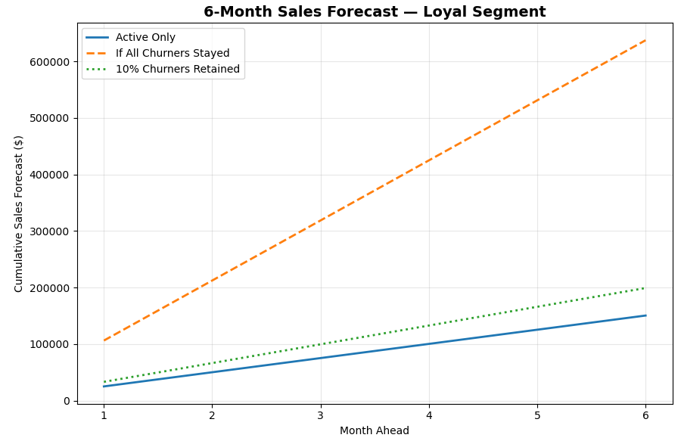
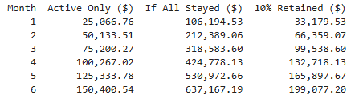
Loyal Cluster
If 10% of churned customers retained, at 6 months

Slide 29
SOFT CHURN ANALYSIS – CUSTOMER SEGMENTATION
Based on 90 days
Further Churn analysis was done : Logistic regression (predictors used – R/F/M)), decision tree (focuses on smaller progressive subsets – however lead to overfitting, XGBoost
* Insert screenshot of info
With these info, it was narrowed down to “Others” base on Yr 2024, R, F scores to identify potential churn customers
Predictive Features were used to further analyze potential cause of reduced engagement“ time since last interaction/ purchases base on quarter period “
perform a K-means

Slide 30
QUESTIONS RAISED
Missing info/ data to better fine tune analysis, soft churn analysis and prediction
The type of subscription model
Feedback data
Little info re the sudden exists in 2023 though sales were good
* Insert screenshot of info

Slide 31
POTENTIAL SOFT CHURN CUSTOMERS
Current overview to justify soft churn
* Insert screenshot of info
-Customer segmentation & soft churn prediction (perform customer segmentation & build soft churn modelt o predict retailers who will disengage
Prepare a dashbard to analyse key business performance metricekey analysis quick oversight of churn

Slide 32
POTENTIAL SOFT CHURN CUSTOMERS
Prediction of why this group should be focused on
* Insert screenshot of info

Slide 33
Kmeans vs RFM
Silhouette score for Kmeans (0.465) is higher than RFM (0.209)
Avg coefficient of variation across for RFM is lower
Chose RFM:
Easy to interpret
Fast execution
Clearer and more direct next-step action
More robust, stable and easy to reproduce
Notes:
For our reference!

Slide 34
CUSTOMER SEGMENTATION - PROFIT ANALYSIS (OVERALL)
Segment | Total Revenue | Avg Revenue | Retailers | Contribution %
Champions | $50M | $177k | 282 | 51.3%
Loyal | $25M | $184k | 136 | 25.6%
Needs Attention | $12M | $66k | 181 | 12.3%
Potential Loyalists | $6M | $37k | 163 | 6.2%
At Risk | $3M | $19k | 162 | 3.0%
Hibernating | $1.7M | $5k | 346 | 1.6%
Notes:
3 biggest contributors OVERALL: Champions, Loyal, Needs Attention

Slide 35
CUSTOMER SEGMENTATION - PROFIT ANALYSIS (2024)
Segment | Total Revenue | Avg Revenue | Retailers | Contribution %
Champions | $12.5M | $95k | 132 | 52.0%
Loyal | $6.2M | $68k | 91 | 25.9%
Needs Attention | $3.1M | $27k | 115 | 12.9%
Potential Loyalists | $1.5M | $18k | 84 | 6.2%
At Risk | $0.7M | $12k | 60 | 2.9%
Hibernating | $0.2M | $3k | 72 | 0.1%
Notes:
3 biggest contributors 2024: Champions, Loyal, Needs Attention [Unchanged]

Slide 36
CUSTOMER SEGMENTATION - LOYAL
REFLECTING RETAILER TYPE
Segment | Retailer Type | Revenue (Invoice Value)
Loyal | CHAIN | 3,487,655.55
 | INDEPENDENT | 2,803,744.20
Notes:
Overall Information - LOYAL cluster

Slide 37
CUSTOMER SEGMENTATION - NEEDS ATTENTION
REFLECTING RETAILER TYPE
Segment | Retailer Type | Revenue (Invoice Value)
Needs Attention | INDEPENDENT | 1,093,373.00
 | OTHERS | 835,812.45
 | CHAIN | 527,610.25
 | WHOLESALER | 181,933.60
Notes:
Wait do we go by year for the revenue?
this is overall oo yeah can!
got it i past below

Slide 38
PREDICTIVE MODELS EXPLORED
Linear Regression
1
2
XGBoost
20XX
why did we pick XGBoost
Feature Assembly
Train / Test Split
Forecasting
Decision Tree
avg_gap - average gap between purchases threshold = 3 * avg_gap soft_churn_label = Binary label indicating churn status, based on the 3× average purchase interval rule.
20% test, 80% train
revenue forecast??
Notes:
ignore just a duplicate backup

Slide 39
Identify top 3 retailers (in the champion cluster?)
top 3 SKUs
sales trend analysis of last 2 years, present NEXT 90-180 days

Slide 40
% of contribution to revenue (Which cluster contributes the most to Quinet's revenue) ✅
Based on the cluster selected:
Monetary value over-time ✅
?Trendline of retailer within each group
If decreasing:
How to re-engage
ROI of re-engagement
If increasing:
How to reward
ROI of reward
Pipeline ahh
Notes:
Which group rakes in the most $? (More interested in the revenue contribution of each group - how have they been transacting in recent time) Observe the trend (sales amount over time) Invest and focus more on the group that may show a worrying trend Percentage share in revenue, timeline of each retailer over the years etc
Present analytic workflow, thought process - visibility of the thought flow, sequence (how power BI was used, which model was used for each trend/analysis etc.)

Slide 41
from sifat
Demonstrate knowledge of analytics workflow - How did steps in analytical workflows were used in solution generation?
Completeness of Solution - Is there a solution to deliver to end stakeholder?
Quality of Content - How well does the recommendations add value to end stakeholder?
Presentation Skill - How engaging and interesting the presentation delivery?
Timeliness - is time limit met? (Note: 12mins presentation + 10mins Q&A)

Slide 42
From Geetika
1. Raw data+processed data files Make sure we have all the raw data and process data files read - e.g. all the csv, excel, text files - have these ready, nicely organised and structured in folder - whenever needed, can just show the file to back up our claim
2. Completeness wrt base question
Completeness of the solution - based on deck brief
Make sure that all points are addressed
Base questions are listed and answered
Checklist with all the components are present

